Slide 1




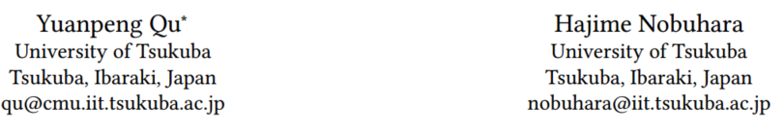





ATAI
Advanced Technique of Artificial Intelligence
ATAI
ChongqingUniversity _{AdvancedTechniqueof}
of Technology Artificial Intelligence
Chongqing University of
Technology
Chongqing University ^{ATAI}
_{of Technology} Advanced Techniqueof
Artificial Intelligence
Chongqing University of Technology
Chongqing University of Technology
Intent-aware Diffusion with Contrastive Learning for
Sequential Recommendation
Code : https://github.com/qyp9909/InDiRec.
—— SIGIR’2025
2025.7.23. • ChongQing
Reported by YaoYao Zhang
1

Slide 2
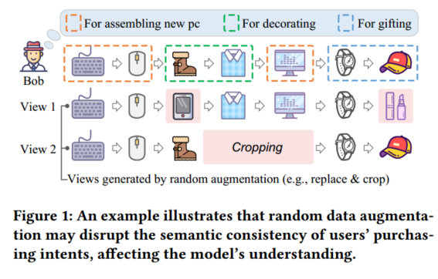
ATAI
Advanced Technique of Artificial Intelligence
ATAI
ChongqingUniversity _{AdvancedTechniqueof}
of Technology Artificial Intelligence
Chongqing University of
Technology
Chongqing University ^{ATAI}
_{of Technology} Advanced Techniqueof
Artificial Intelligence
Chongqing University of Technology
Chongqing University of Technology
Motivation
i) Most existing methods generate multiple views through random data augmentation, but such random augmentation can introduce noise，overlooks users' underlying purchase intentions.

Slide 3
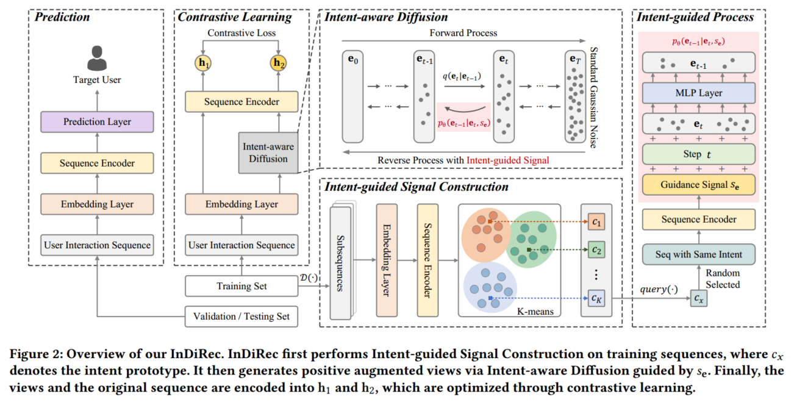
ATAI
Advanced Technique of Artificial Intelligence
ATAI
ChongqingUniversity _{AdvancedTechniqueof}
of Technology Artificial Intelligence
Chongqing University of
Technology
Chongqing University ^{ATAI}
_{of Technology} Advanced Techniqueof
Artificial Intelligence
Chongqing University of Technology
Chongqing University of Technology

Slide 4

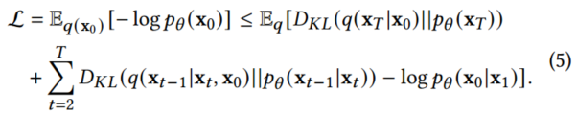
ATAI
Advanced Technique of Artificial Intelligence
ATAI
ChongqingUniversity _{AdvancedTechniqueof}
of Technology Artificial Intelligence
Chongqing University of
Technology
Chongqing University ^{ATAI}
_{of Technology} Advanced Techniqueof
Artificial Intelligence
Chongqing University of Technology
Chongqing University of Technology
Method

Slide 5
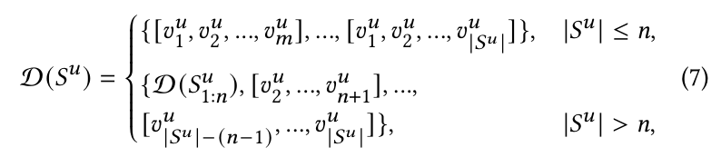
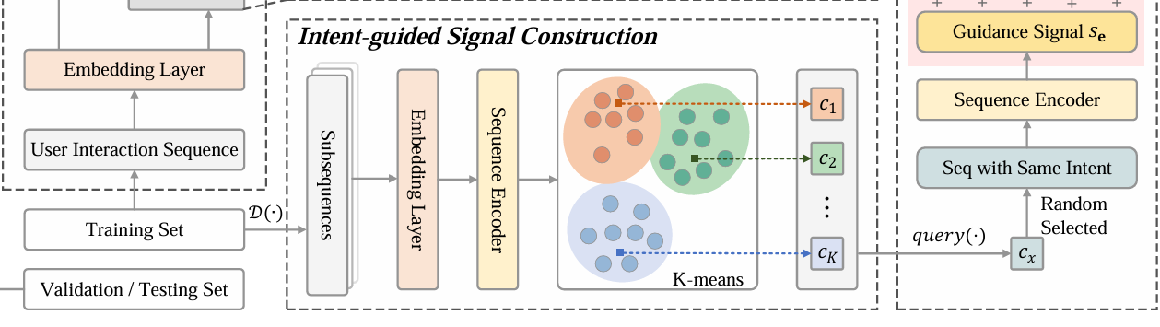

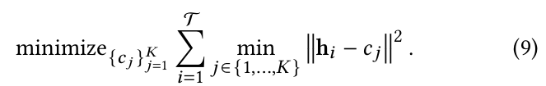

ATAI
Advanced Technique of Artificial Intelligence
ATAI
ChongqingUniversity _{AdvancedTechniqueof}
of Technology Artificial Intelligence
Chongqing University of
Technology
Chongqing University ^{ATAI}
_{of Technology} Advanced Techniqueof
Artificial Intelligence
Method
Chongqing University of Technology
Chongqing University of Technology

Slide 6
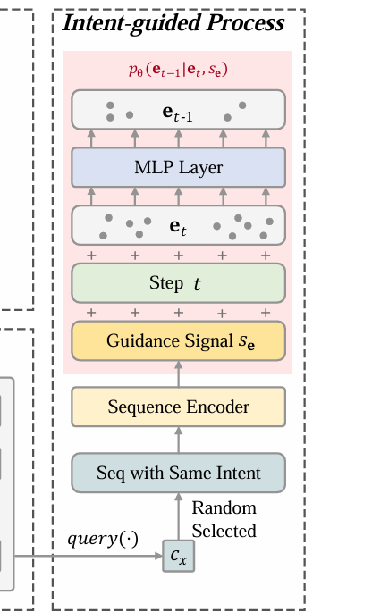

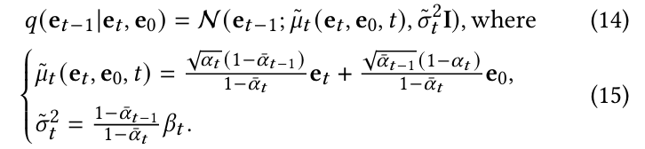
ATAI
Advanced Technique of Artificial Intelligence
ATAI
ChongqingUniversity _{AdvancedTechniqueof}
of Technology Artificial Intelligence
Chongqing University of
Technology
Chongqing University ^{ATAI}
_{of Technology} Advanced Techniqueof
Artificial Intelligence
Method
Chongqing University of Technology
Chongqing University of Technology

Slide 7

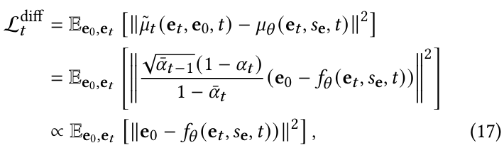

ATAI
Advanced Technique of Artificial Intelligence
ATAI
ChongqingUniversity _{AdvancedTechniqueof}
of Technology Artificial Intelligence
Chongqing University of
Technology
Chongqing University ^{ATAI}
_{of Technology} Advanced Techniqueof
Artificial Intelligence
Method
Chongqing University of Technology
Chongqing University of Technology

Slide 8
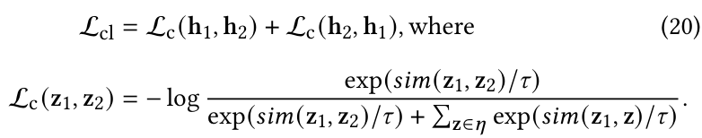
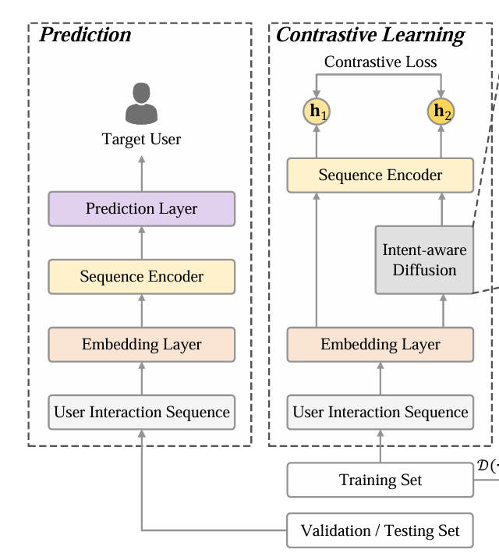

ATAI
Advanced Technique of Artificial Intelligence
ATAI
ChongqingUniversity _{AdvancedTechniqueof}
of Technology Artificial Intelligence
Chongqing University of
Technology
Chongqing University ^{ATAI}
_{of Technology} Advanced Techniqueof
Artificial Intelligence
Method
Chongqing University of Technology
Chongqing University of Technology

Slide 9
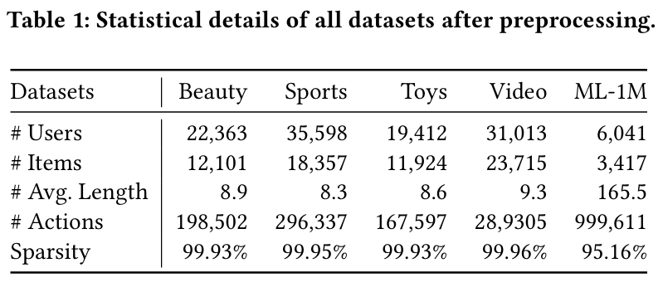
ATAI
Advanced Technique of Artificial Intelligence
ATAI
ChongqingUniversity _{AdvancedTechniqueof}
of Technology Artificial Intelligence
Chongqing University of
Technology
Chongqing University ^{ATAI}
_{of Technology} Advanced Techniqueof
Artificial Intelligence
Chongqing University of Technology
Experiments
Chongqing University of Technology

Slide 10
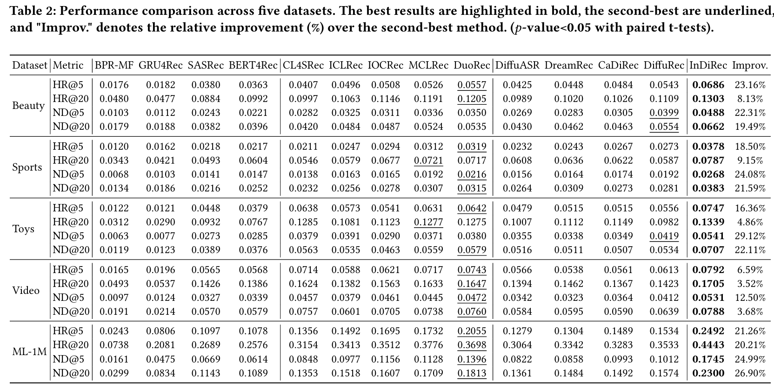
ATAI
Advanced Technique of Artificial Intelligence
ATAI
ChongqingUniversity _{AdvancedTechniqueof}
of Technology Artificial Intelligence
Chongqing University of
Technology
Chongqing University ^{ATAI}
_{of Technology} Advanced Techniqueof
Artificial Intelligence
Chongqing University of Technology
Chongqing University of Technology

Slide 11
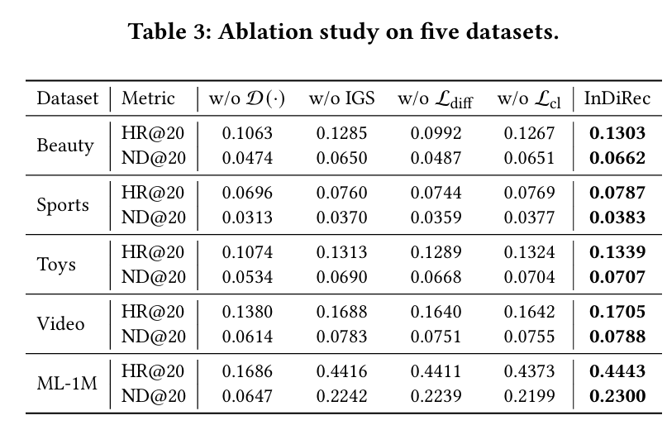
ATAI
Advanced Technique of Artificial Intelligence
ATAI
ChongqingUniversity _{AdvancedTechniqueof}
of Technology Artificial Intelligence
Chongqing University of
Technology
Chongqing University ^{ATAI}
_{of Technology} Advanced Techniqueof
Artificial Intelligence
Chongqing University of Technology
Chongqing University of Technology

Slide 12
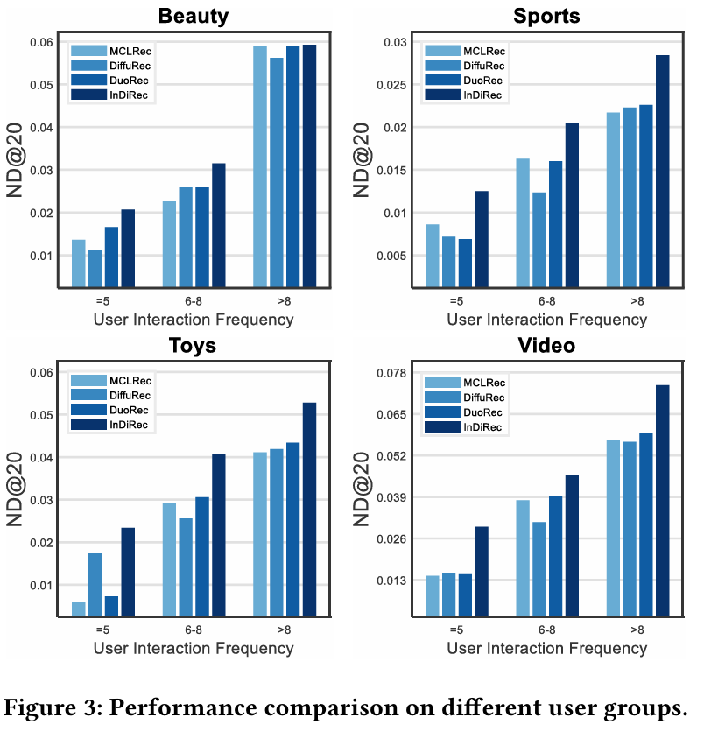
ATAI
Advanced Technique of Artificial Intelligence
ATAI
ChongqingUniversity _{AdvancedTechniqueof}
of Technology Artificial Intelligence
Chongqing University of
Technology
Chongqing University ^{ATAI}
_{of Technology} Advanced Techniqueof
Artificial Intelligence
Chongqing University of Technology
Chongqing University of Technology

Slide 13
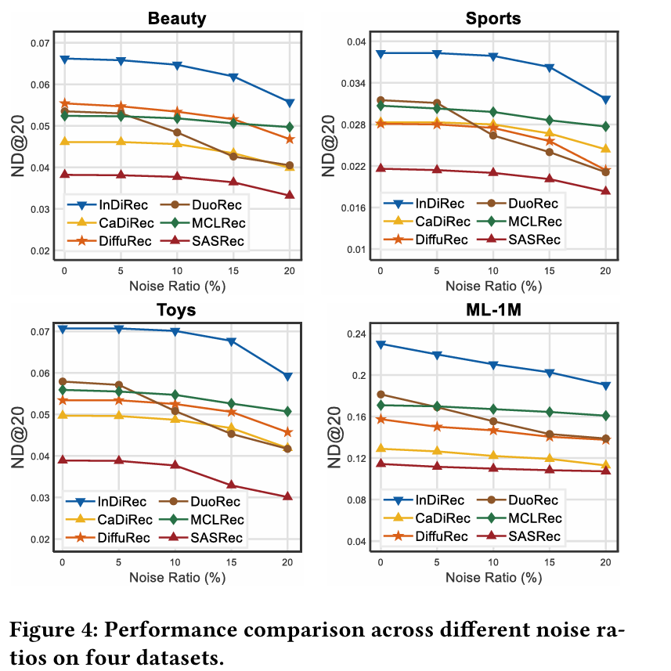
ATAI
Advanced Technique of Artificial Intelligence
ATAI
ChongqingUniversity _{AdvancedTechniqueof}
of Technology Artificial Intelligence
Chongqing University of
Technology
Chongqing University ^{ATAI}
_{of Technology} Advanced Techniqueof
Artificial Intelligence
Chongqing University of Technology
Chongqing University of Technology

Slide 14
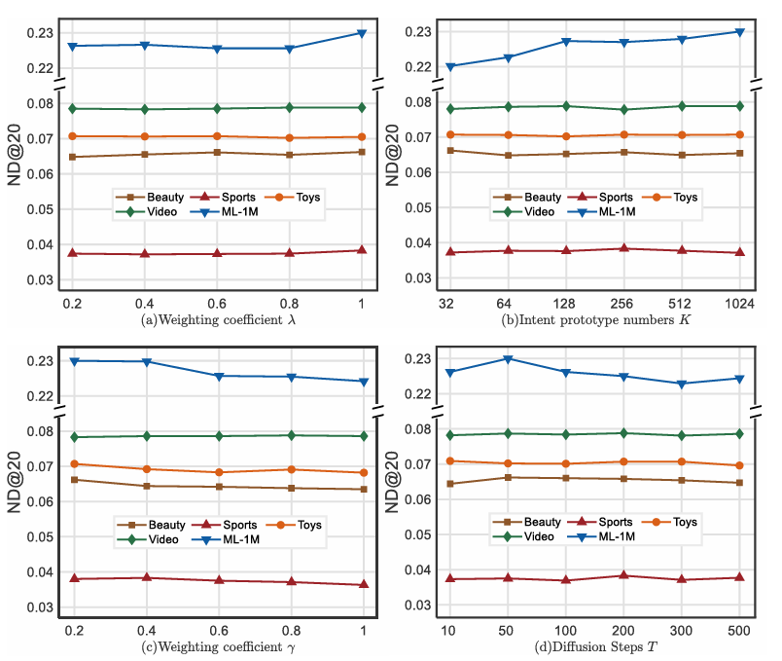
ATAI
Advanced Technique of Artificial Intelligence
ATAI
ChongqingUniversity _{AdvancedTechniqueof}
of Technology Artificial Intelligence
Chongqing University of
Technology
Chongqing University ^{ATAI}
_{of Technology} Advanced Techniqueof
Artificial Intelligence
Chongqing University of Technology
Chongqing University of Technology

Slide 15
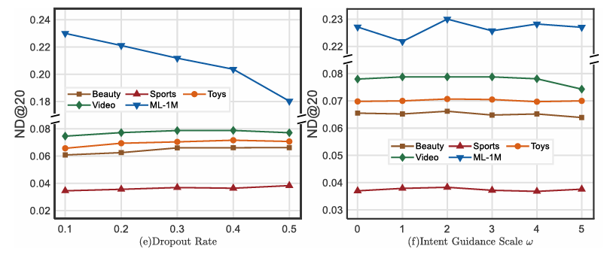
ATAI
Advanced Technique of Artificial Intelligence
ATAI
ChongqingUniversity _{AdvancedTechniqueof}
of Technology Artificial Intelligence
Chongqing University of
Technology
Chongqing University ^{ATAI}
_{of Technology} Advanced Techniqueof
Artificial Intelligence
Chongqing University of Technology
Chongqing University of Technology

Slide 16
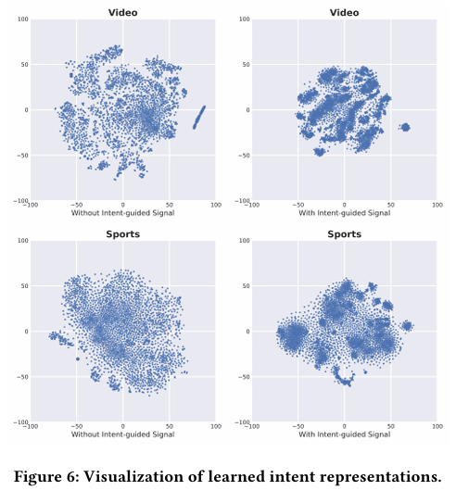
ATAI
Advanced Technique of Artificial Intelligence
ATAI
ChongqingUniversity _{AdvancedTechniqueof}
of Technology Artificial Intelligence
Chongqing University of
Technology
Chongqing University ^{ATAI}
_{of Technology} Advanced Techniqueof
Artificial Intelligence
Chongqing University of Technology
Chongqing University of Technology

Slide 17
ATAI
Advanced Technique of Artificial Intelligence
ATAI
ChongqingUniversity _{AdvancedTechniqueof}
of Technology Artificial Intelligence
Chongqing University of
Technology
Chongqing University ^{ATAI}
_{of Technology} Advanced Techniqueof
Artificial Intelligence
Chongqing University of Technology
Chongqing University of Technology
Thanks!

